Slide 1



EDA Project – Global Electric Vehicle
Project Group 7
1. Avinaba Ghosh
2. Deepak M
3. Helen Mary
4. Manjushree E
5. Venkatesh K

Slide 2



Introduction
Data Set discusses recent developments in electric mobility across the globe.
Combining historical analysis with projections to 2030.
The report is examined using the Python language for analysis of key areas
Electric Vehicles
Charging Infrastructure
Energy usage , consumption and future demand.

Slide 3

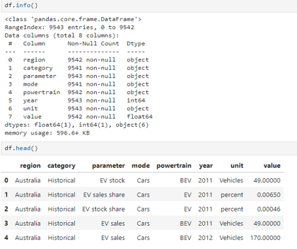
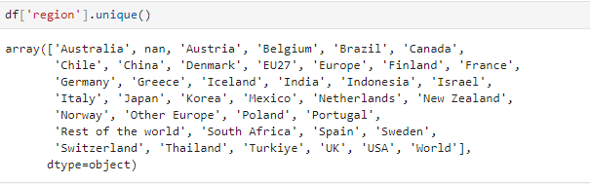
Data Set Details
Importing Libraries
Importing data in Python varies by format (CSV, Excel, JSON, SQL).
Common libraries used include:
pandas: For CSV and Excel files.
json: For JSON data.
sqlite3: For SQL databases.
Reading Data
Reading a dataset in Python usually involves loading data from a file into a structure for analysis using pandas library
This Data set comprises of
Used unique function to view 9543 rows and 8 columns

Slide 4
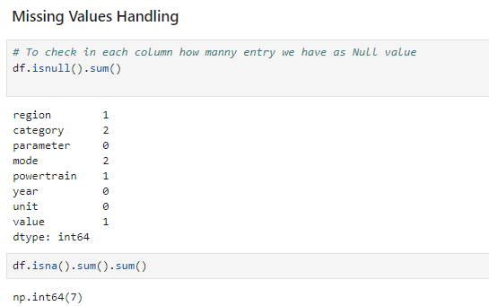
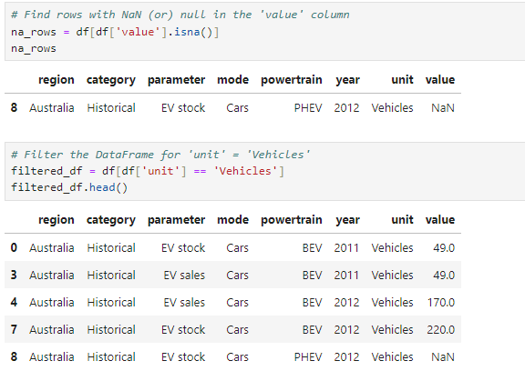
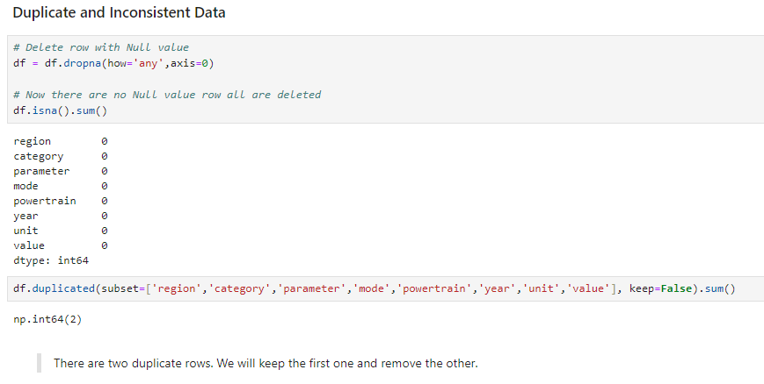
Data Cleaning and Handling the duplicates
Data Cleaning is a crucial step in data analysis, ensuring that your dataset is accurate, consistent, and ready for analysis.
Missing information: There are 5 columns with few missing values. Sum of missing values are 7.
The missing values are found and dropped using “dropna” function
Inconsistent data can lead to faulty analysis, untrustworthy outcomes.
Data inconsistencies can occur for a variety of reasons, including mistakes in data entry, data processing, or data integration
Duplicate Values : There are 2 duplicate rows.
In which the first one is retained.

Slide 5
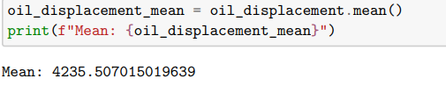
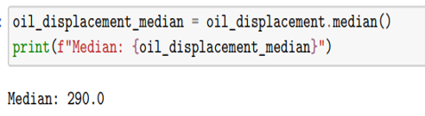
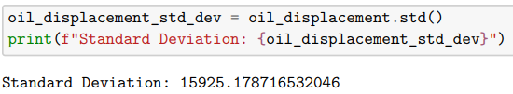
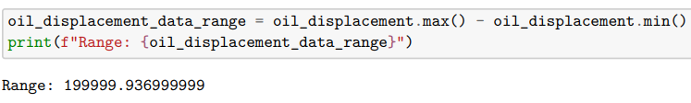
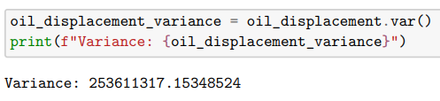
Descriptive Statistics
Mean
Median
Standard Deviation
The mean is the average value of the data
The middle value of a sorted dataset, dividing it into two equal halves.
A measure of the dispersion of a dataset, indicating the degree of deviation from the mean.
Range
Variance
The difference between the maximum and minimum values in a dataset
The average of the squared differences from the mean, indicating the degree of spread in the dataset

Slide 6
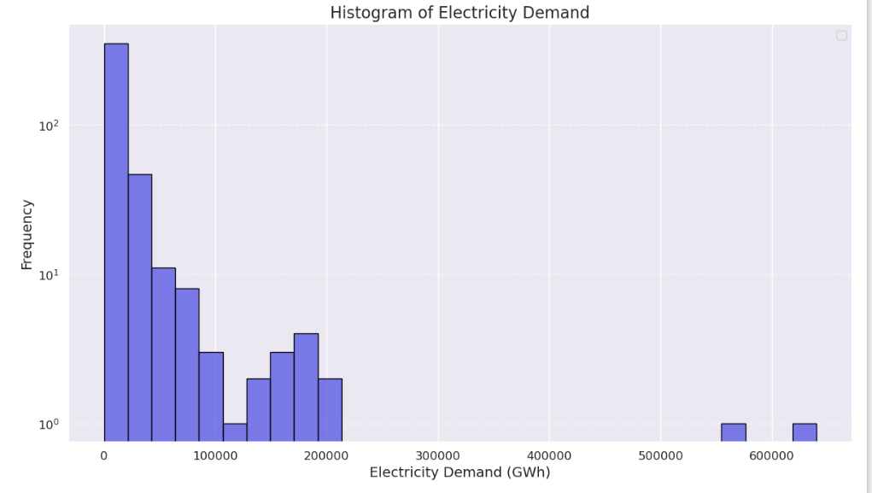
Data Visualization - Histogram
Histograms are a powerful tool for visualizing the distribution of numerical data. In Python, histograms can be easily created using libraries like Matplotlib and Seaborn.
Histogram of Electricity Demand tells us about the Electricity Demand in GWh wrt Frequency
X axis = Electricity Demand in GWh
y axis = Frequency of the values

Slide 7
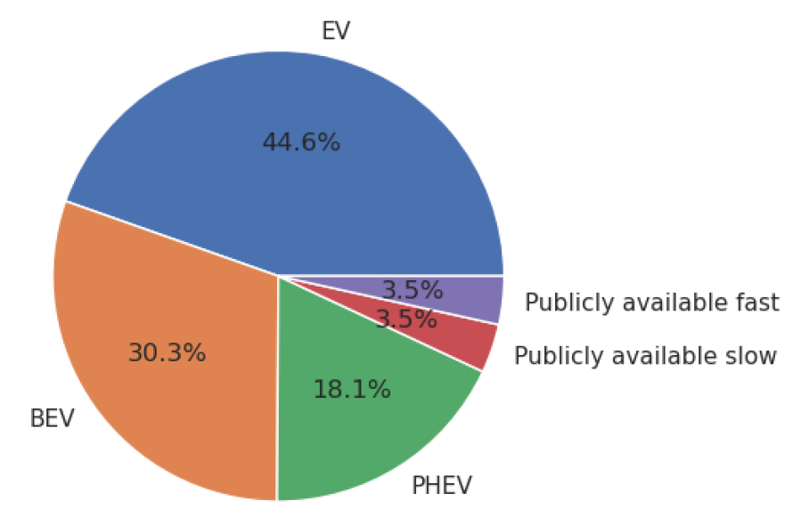
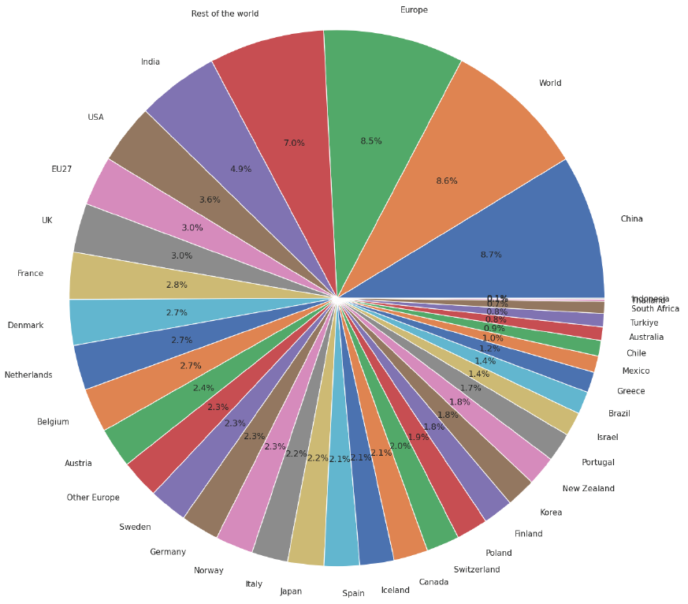
Data Visualization – Pie Plot
Statistical data can be represented in a circular graph where the circle is divided into portions that denote a particular data
Observation: EV - Electric Vehicle' Sector has the highest percentage of cars in demand manufacturer.
Observation: When we checked the % of EV share in different Regions of the world and China has maximum share of 9.7%

Slide 8
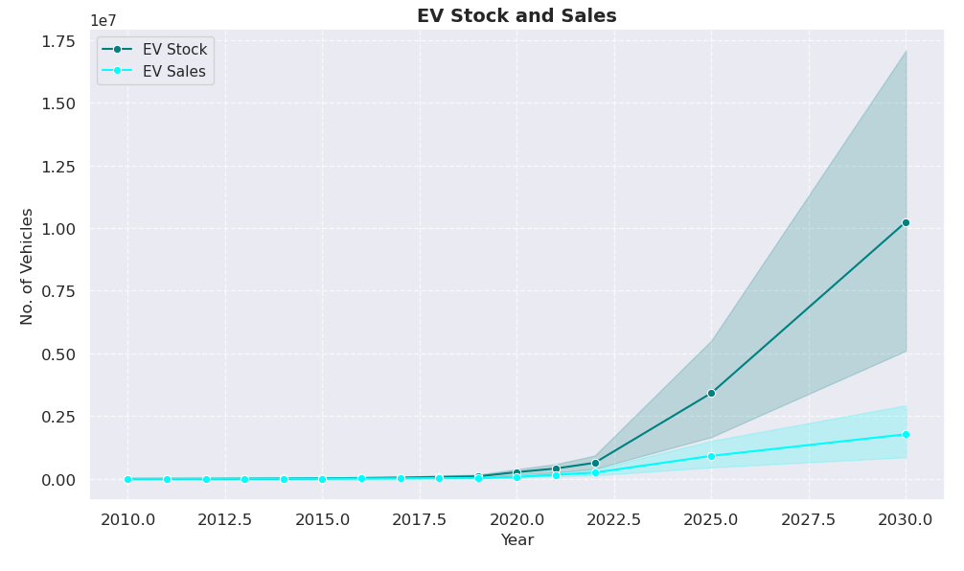
Data Visualization – Line Plot
A Line plot is a relational data visualization showing how one continuous variable changes when another does. It's one of the most common graphs widely used in finance, sales, marketing, healthcare, natural sciences, and more.

Slide 9
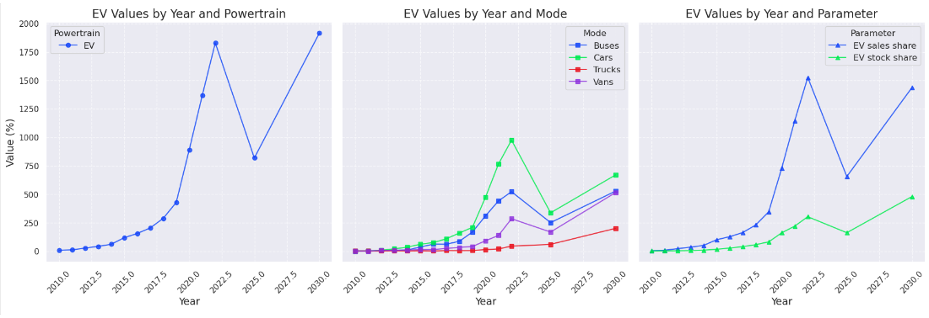
Data Visualization – Line Plot
From the first plot, we can observe that there is a substantial increase in the number of EV after the year 2020. It is also predicted to be more by 2030.
From the second plot, we can observe that EV cars have increased after 2020 compared with Trucks, Vans or Buses.
From the third plot, the EV sales share and the EV stock share have also increased after 2020. There is also a fall in the sales and stock share by 2025. But it is predicted to rise by 2030.

Slide 10
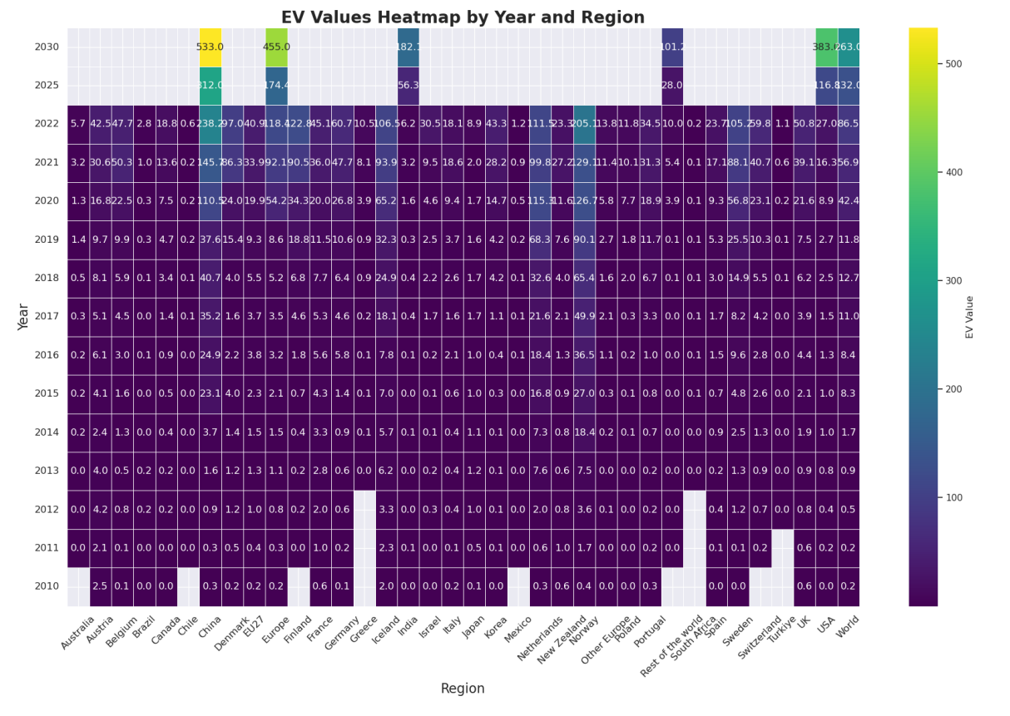
Data Visualization – Heat Map
A Heatmap is a graphical representation of data where individual values are represented by colors. Heatmaps are particularly useful for visualizing correlation matrices, frequency distributions, or any other data where you want to highlight patterns or variations across two dimensions. In Python, you can create heatmaps using libraries like Seaborn and Matplotlib

Slide 11
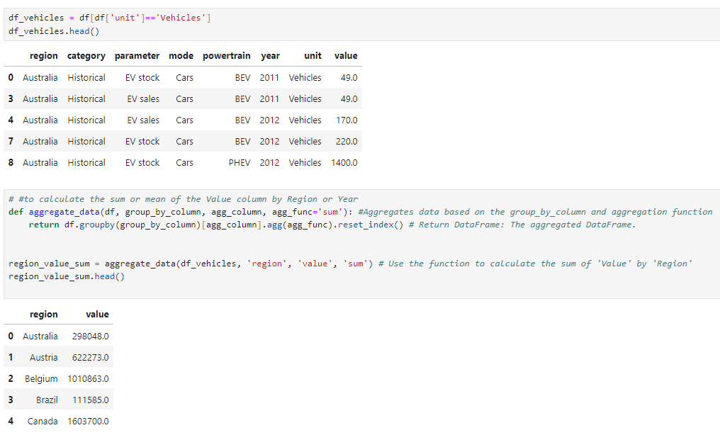
Group Analysis
The groupby(): function in Pandas is used to split the data into groups based on some criteria. The .count() function then counts the number of non-null values within each group
The .agg() function is then used to apply one or more aggregation operations (like sum, mean, or max) to each group, summarizing the data in meaningful ways.

Slide 12
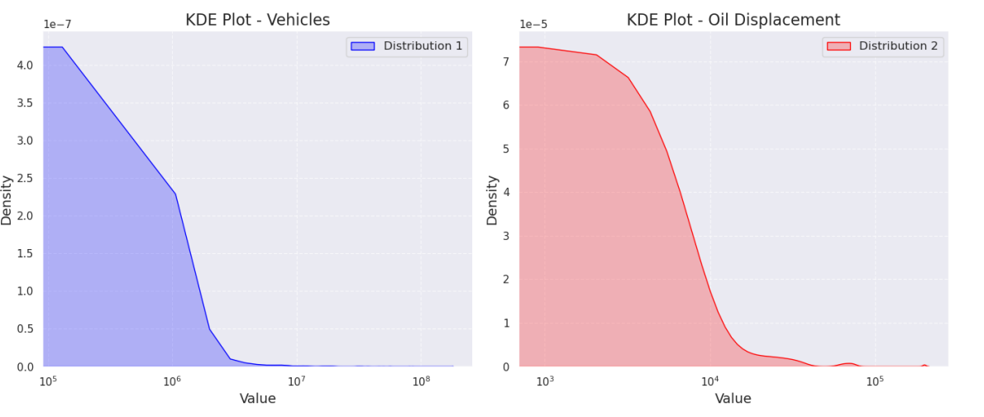
Feature Analysis– Density Plot
A Density plot (or Kernel Density Estimate, KDE plot) is a smooth, continuous representation of the distribution of a dataset. Unlike histograms, which provide a discrete count of data points within specified bins, density plots offer a more refined view of the underlying distribution.

Slide 13
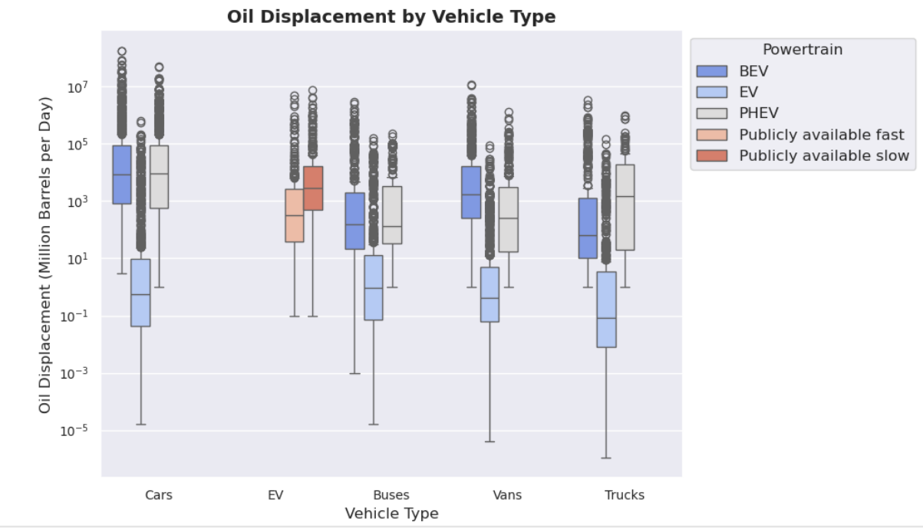
Box Plot
A Box plot (or whisker plot) is a graphical representation that summarizes the distribution of a dataset. It provides a visual indication of the central tendency, variability, and presence of outliers in the data. Box plots are particularly useful for comparing distributions across multiple groups

Slide 14
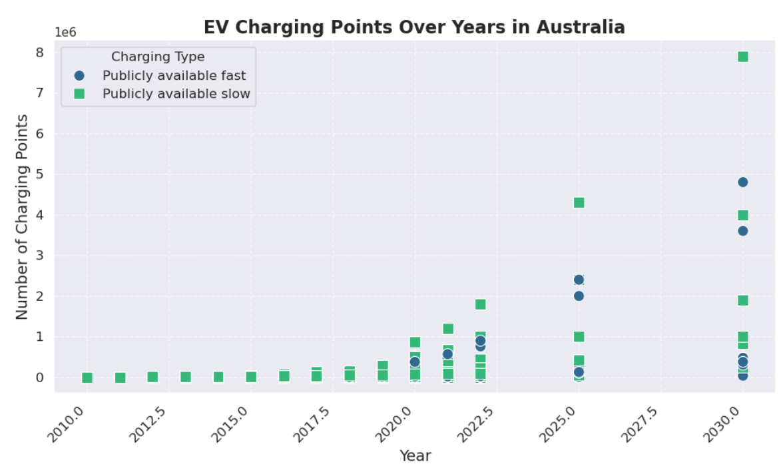
Scatter Plot
A Scatter plot is a graphical representation of the relationship between two numerical variables. It displays individual data points on a two-dimensional plane, making it easy to observe patterns, trends, and potential correlations between the variables.

Slide 15
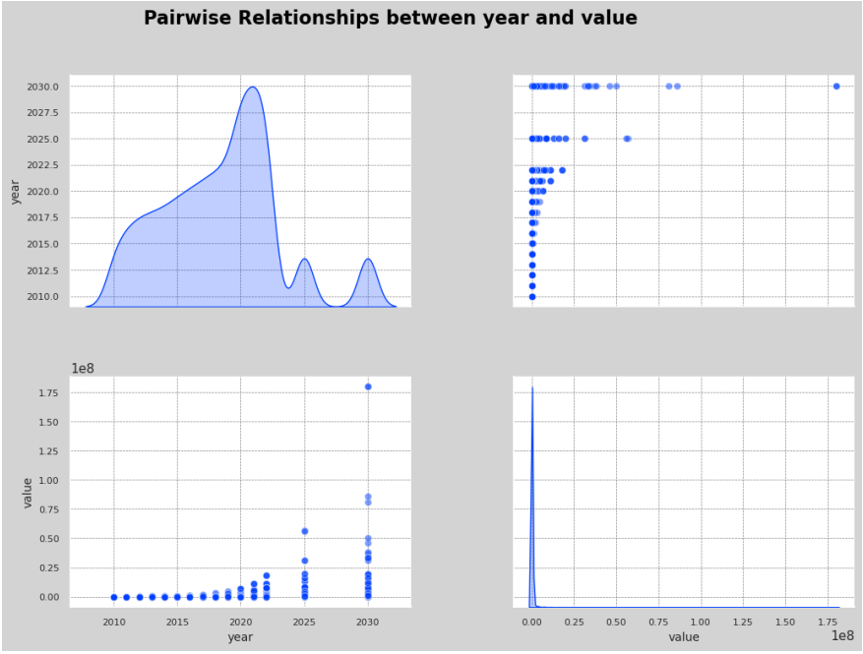
Pair Plot
A Pair plot is a powerful visualization tool that allows you to explore the relationships between multiple numerical variables in a dataset. It creates a grid of scatter plots for each pair of variables, along with histograms or density plots along the diagonal to show the distribution of each variable.
Observation: When the pair plot constructed with Value Vs Year , it is observed that
volume of EV max in year 2030 compared to other

Slide 16
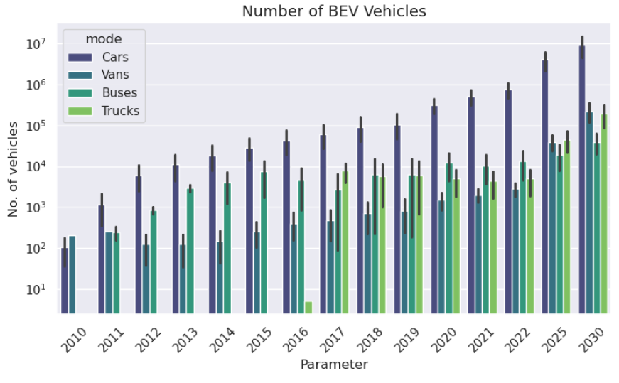
Advance Python Techniques
A Bar plot is a common type of data visualization used to display and compare the frequencies or values of different categories.
In this case, the bar plot graph explains the number of BEV (Battery Electric Vehicles) used on a yearly basis, illustrating the growth or change in the adoption of BEVs over time.

Slide 17
Insights and Conclusion
Positive Growth Trend: Increasing EV sales and stock indicate strong market expansion driven by consumer acceptance and environmental awareness.
Infrastructure Investment Needed: High EV sales in regions lacking charging infrastructure highlight the need for more charging stations to support adoption.
Diverse Preferences: The range of powertrain types (BEVs, PHEVs) shows consumers are considering options based on factors like range anxiety, suggesting manufacturers should adapt.
Regional Disparities: Differences in EV adoption rates across regions call for targeted policies and marketing strategies to encourage growth.
Sales vs. Stock Dynamics: Analyzing EV stock and sales can reveal market health; high sales relative to stock may indicate demand but also potential supply chain issues.
Further Research Required: Low EV stock despite high sales necessitates investigation into consumer behavior and supply chain challenges for sustainable development.
Market Opportunities: Identifying regions with low EV adoption can inform targeted incentives and infrastructure investments to spur growth.

Slide 18

Thank You

